Slide 1
Smart attendance

Slide 2
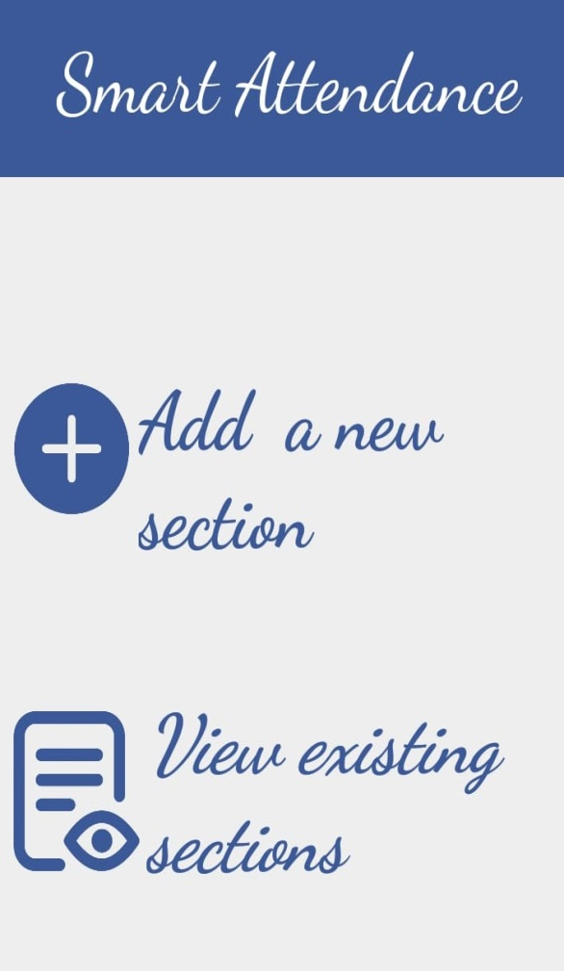

Idea Description:
the application aim to record student attendance using python language, and this is done by
photographing student IDs.
When the application is launched,
that image will appear.

Slide 3
Client-server system:
Server:
All the processing is on the server .
It can serve multiple clients currently as it based on multithreading using java and python sockets.
client:
It is the android application on the mobile which the user interface with .

Slide 4
Processing:
First we convert the image to gray scale ,then we discover the edges using canny detection and finally we detect containers on the image.
To extract ids from image we used tesseract-ocr .

Slide 5
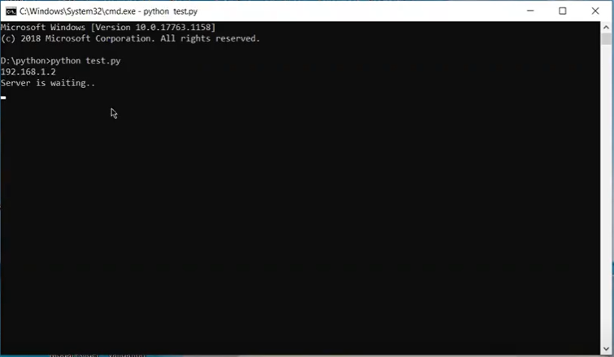
How to use the application:
1.First server running
And waiting for connection with client

Slide 6
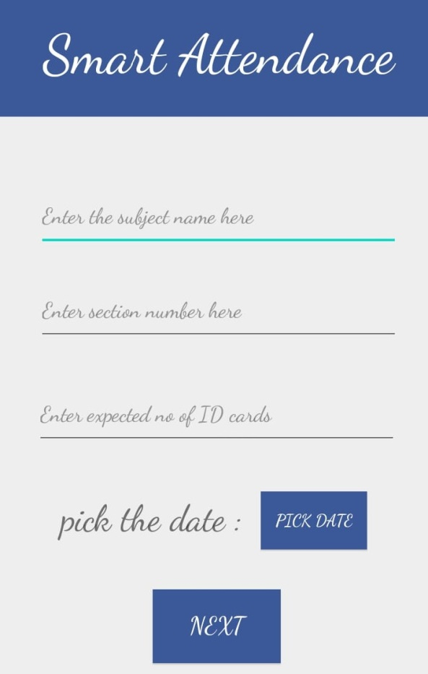
How to use the application:
2.Allow the user to Enter the subject name, department number, and expected number of ID cards and choose date.

